Slide 1
Legal Question Answering using Ranking SVM and Deep Convolutional Neural Network
宋文辉
2020/4/27
Notes:
通过实例级对抗性训练的远程监督去噪

Slide 2
Basic Information
Org: Japan Advanced Institute of Science and Technology
Hung Yen University of Education and Technology
Task：Legal Question Answering
Publication: arXiv e-prints
Pub Date: March 2017

Slide 3
Ranking SVM
Learning to Rank(简称LTR)用机器学习的思想来解决排序问题。LTR有三种主要的方法：PointWise，PairWise，ListWise。
Ranking SVM算法是PairWise方法的一种，由R. Herbrich等人在2000提出, T. Joachims介绍了一种基于用户Clickthrough数据使用Ranking SVM来进行排序的方法(SIGKDD, 2002)
Ranking SVM是一种Pointwise的排序算法, 给定查询q, 文档d₁>d₂>d₃(亦即文档d₁比文档d₂相关, 文档d₂比文档d₃相关, x₁, x₂, x₃分别是d₁, d₂, d₃的特征)。为了使用机器学习的方法进行排序，我们将排序转化为一个分类问题。我们定义新的训练样本, 令x₁-x₂, x₁-x₃, x₂-x₃为正样本,令x₂-x₁, x₃-x₁, x₃-x₂为负样本, 然后训练一个二分类器(支持向量机)来对这些新的训练样本进行分类
LTR: https://blog.csdn.net/clheang/article/details/45674989
RSVM: https://blog.csdn.net/clheang/article/details/45767103

Slide 4
Introduction
legal texts contain strict logical connections of law-specific words, phrases, issues, concepts and factor
makes information retrieval and question answering on legal domain become more complicated
manual knowledge engineering(KE)
it is hard to be applied in practice because of time and financial cost
NLP

Slide 5
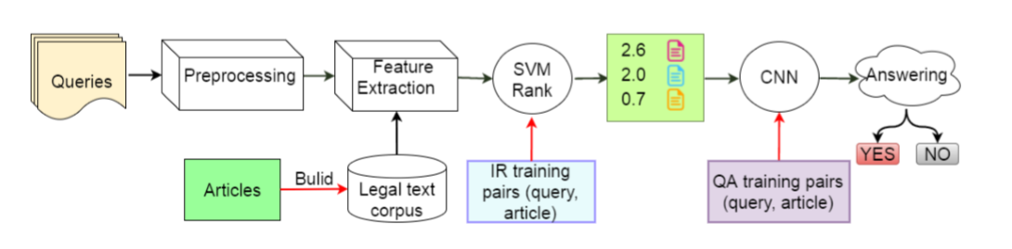
Method
a pipeline framework to two important tasks: IR and QA
L2R model (Ranking SVM)
classifier(CNN)

Slide 6
Dataset
Org:阿尔伯塔大学
Source: http://webdocs.cs.ualberta.ca/∼miyoung2/COLIEE2016
COLIEE:
Competition on Legal Information Extraction/Entailment
Japanese Civil Code | Paragraphs
1,105 articles | 412 pairs
split
Japanese Civil Code | Single-Paragraphs
1,663 articles | 412 pairs

Slide 7
Dataset
tokenization
POS tagging
lemmatization
stopword removal
Terms were tokenized and lemmatized using NLTK, and POS tagged by Stanford Tagger

Slide 8



LIR-tf_idf

Slide 9
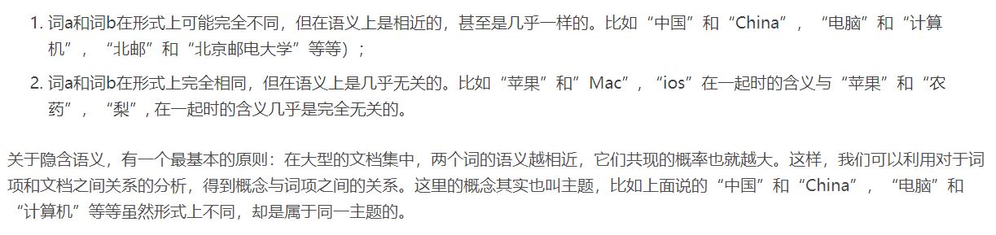
LIR-LSI
LSI,英文：Latent Semantic Indexing的缩写，中文意译是潜在语义索引，指的是通过海量文献找出词汇之间的关系。当两个词或一组词大量出现在一个文档中时，这些词之间就可以被认为是语义相关的。
词袋”模型假设一个段落的词汇之间出现频率是无关联的。因此通过给文档建立文档词汇向量表维度很大，并且有数据稀疏问题，通过LSI建模，通过大量的统计，得出相关词汇构成一个潜在的主题，本质是给词汇聚类，达到降维的目的。

Slide 10
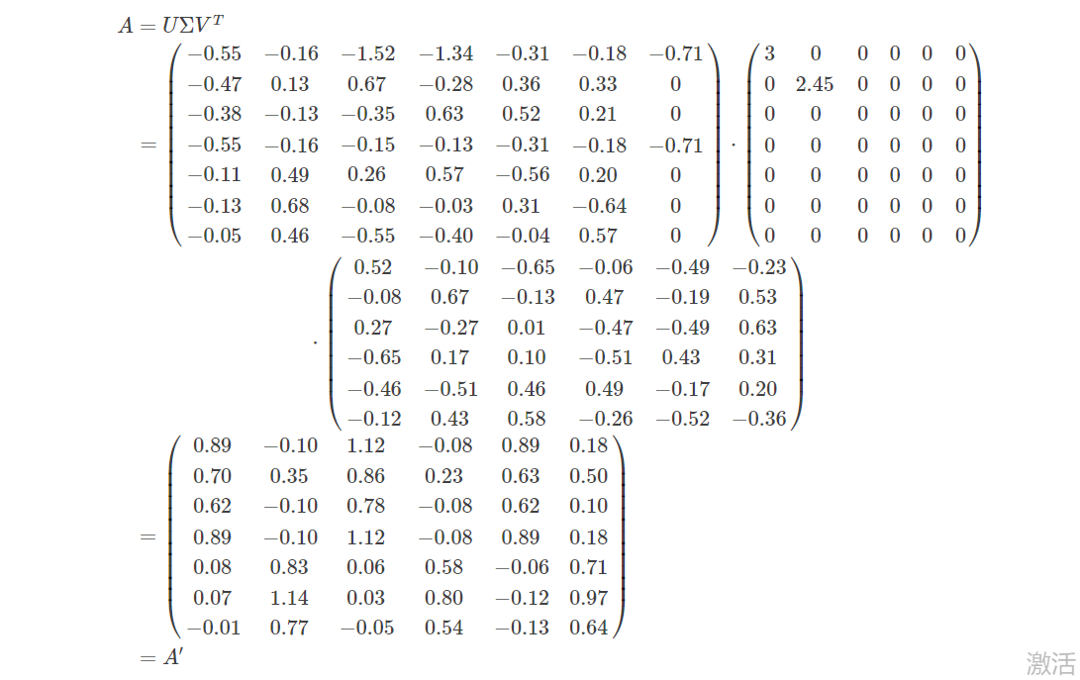
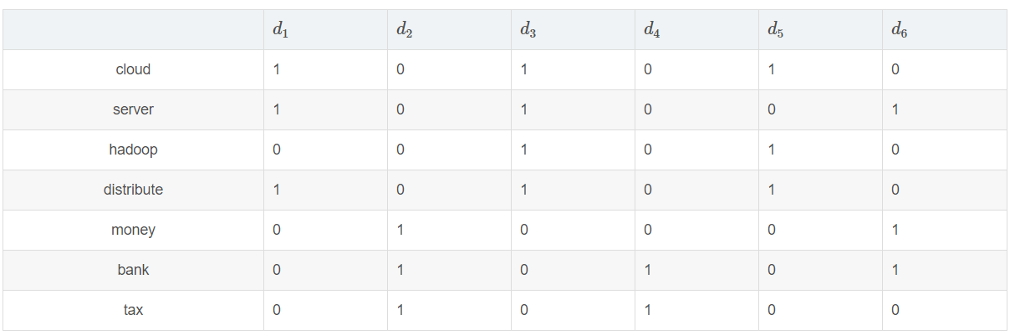
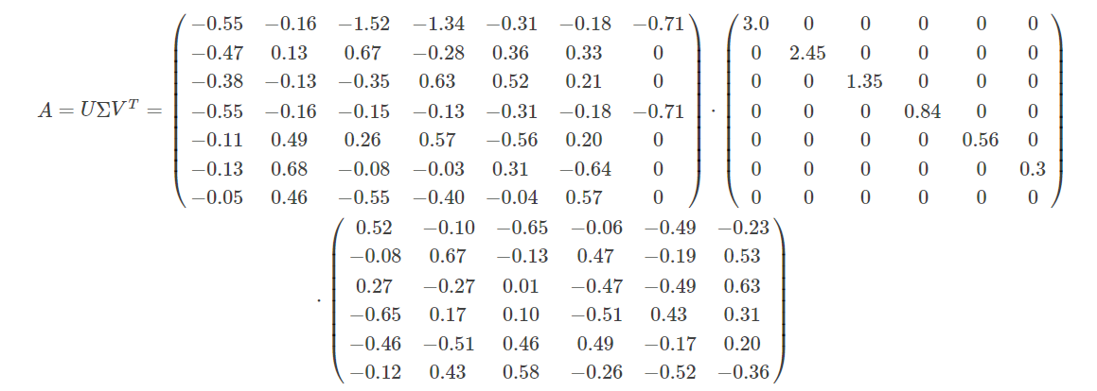
LIR-LSI

Slide 11
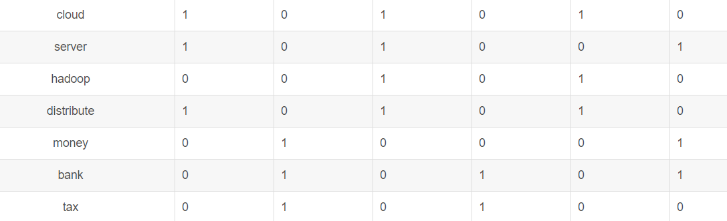
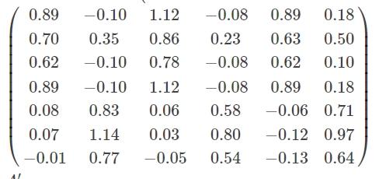
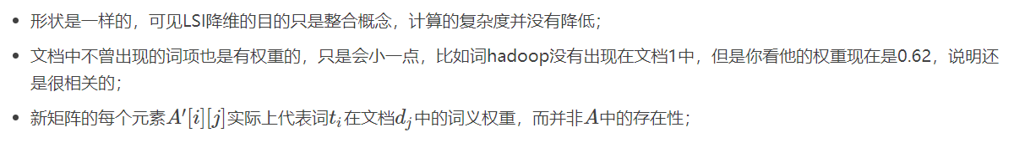
LIR-LSI

Slide 12
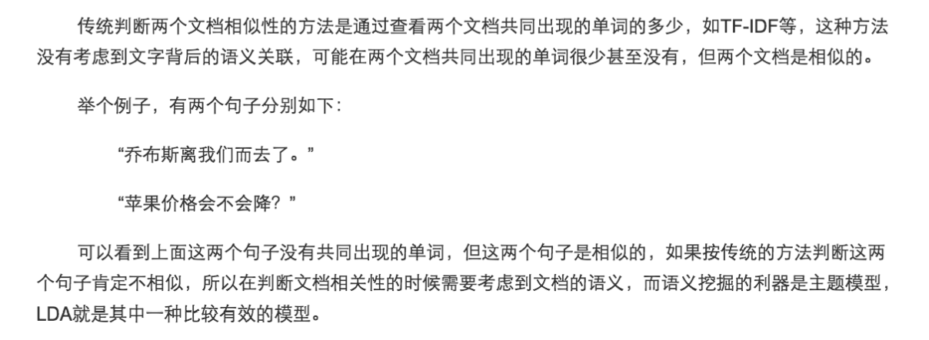
LIR-LDA
LDA: Latent Dirichlet Allocation
LSI, LDA, TF-IDF are extracted by using gensim library

Slide 13
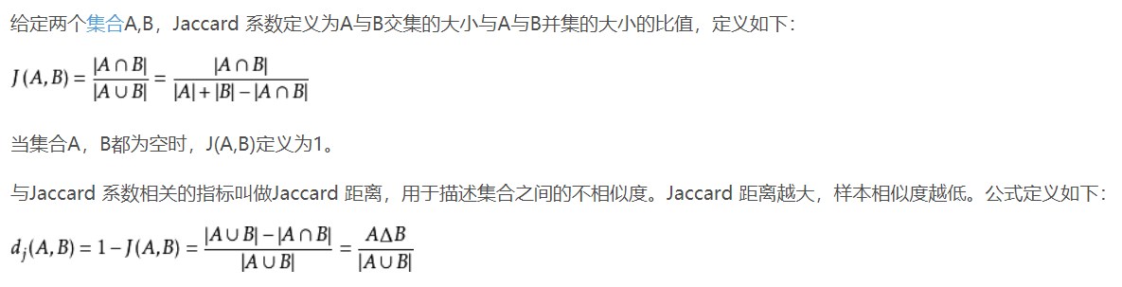
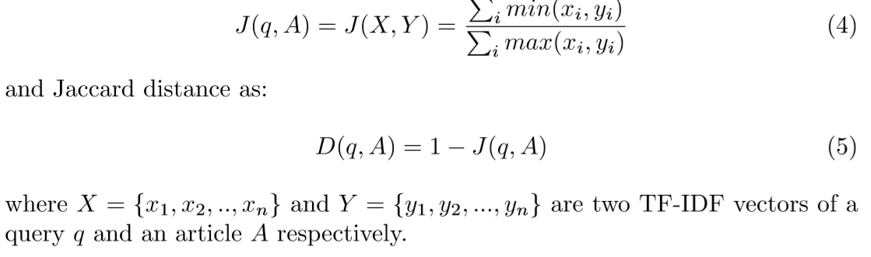
LIR-Jaccard

Slide 14
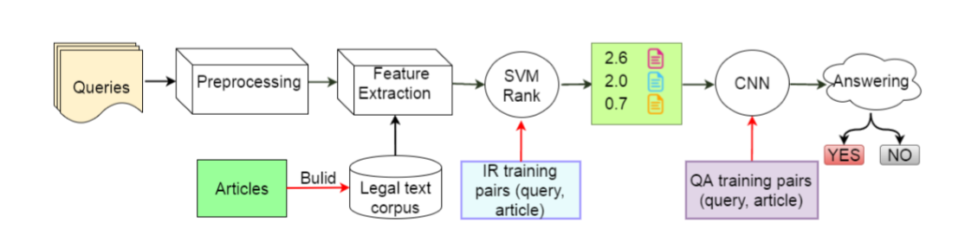
LQA

Slide 15
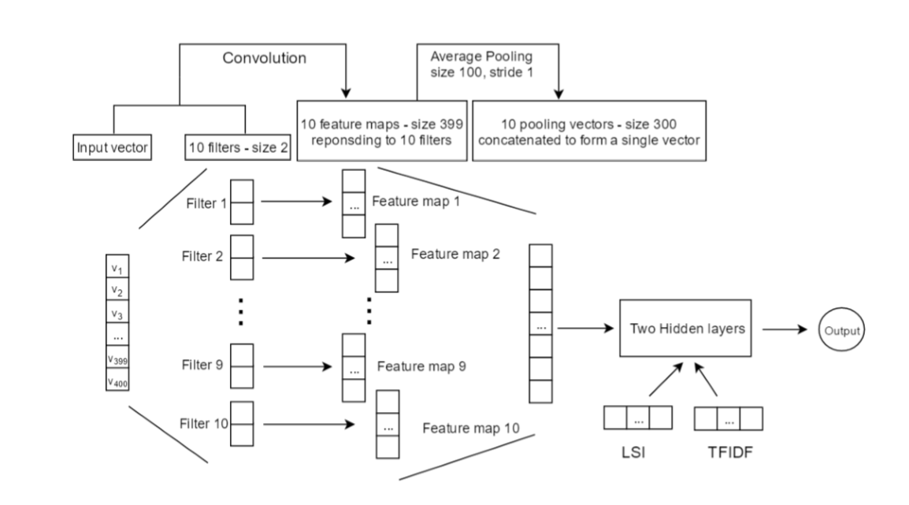
LQA
Task: a binary classification task
Model: CNN
Limitation: small dataset ---> additional features

Slide 16
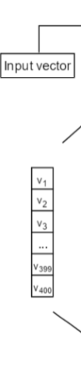
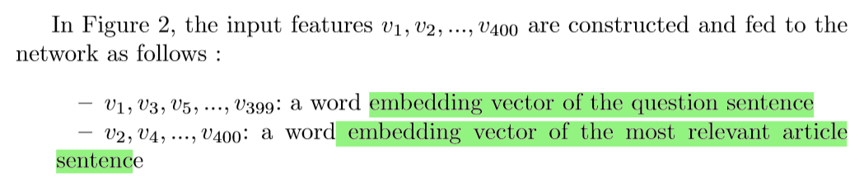
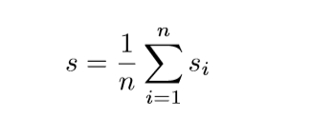
LQA-input_vector
Word_Embedding: Word2vec(200)
Sent_Embedding

Slide 17

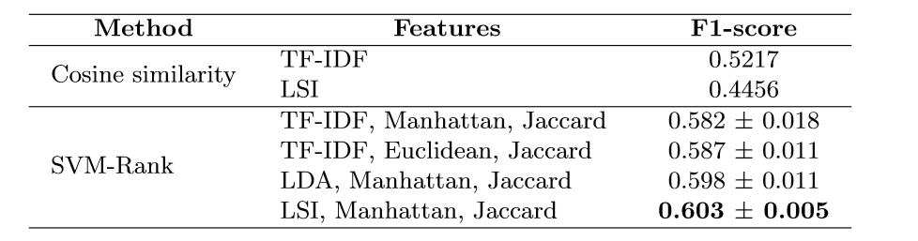
Results and Discussion--IR
Evaluator:

Slide 18
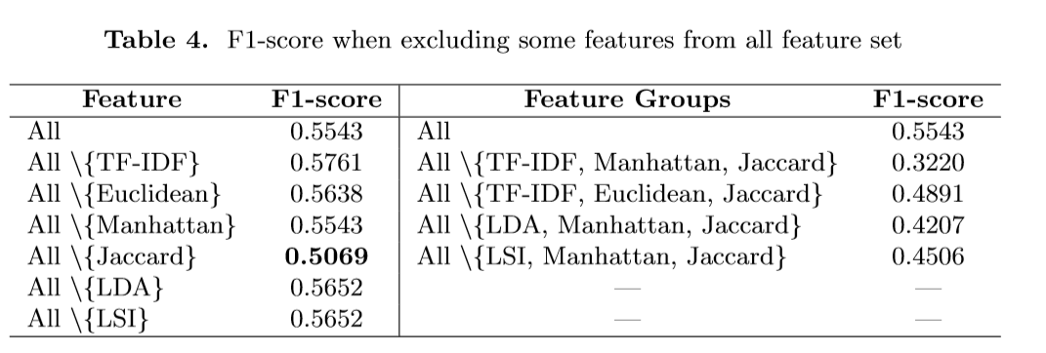
Results and Discussion--IR

Slide 19
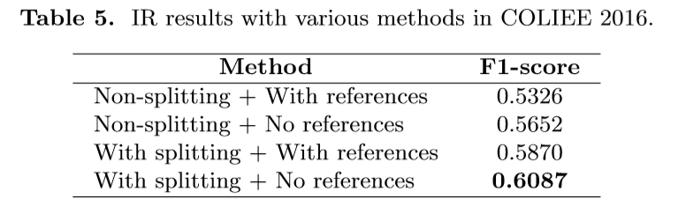
Results and Discussion--IR

Slide 20
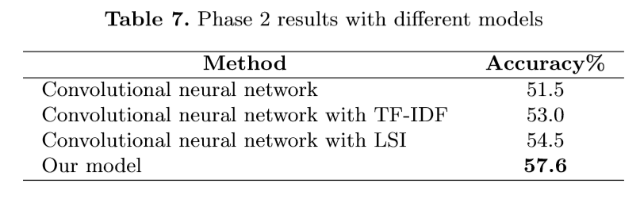
Results and Discussion--QA

Slide 21
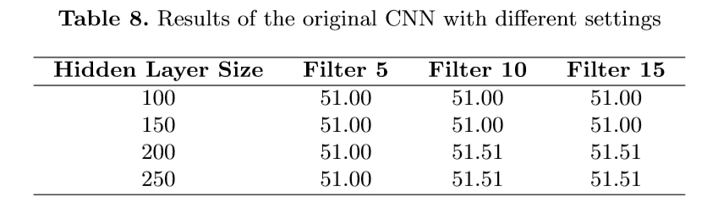
Results and Discussion--QA

Slide 22
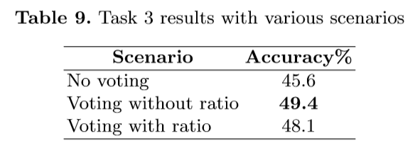
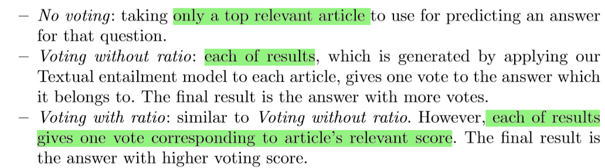
Results and Discussion--QA

Slide 23
Conclusion
the CNN model is sensitive to initial values of parameters and exerts higher accuracy when adding auxiliary features.
there should be more evaluation of SVM-Rank and other L2R methods to observe how they perform on this legal data using the same feature set

Slide 24
Legal Document Retrieval using Document Vector Embeddings and Deep Learning
Notes:
通过实例级对抗性训练的远程监督去噪

Slide 25
Basic Information
Org: University of Moratuwa(莫勒图沃大学)
University of London
Task： Information Retrieval
Publication: science and information conference
Pub Date: 2018

Slide 26
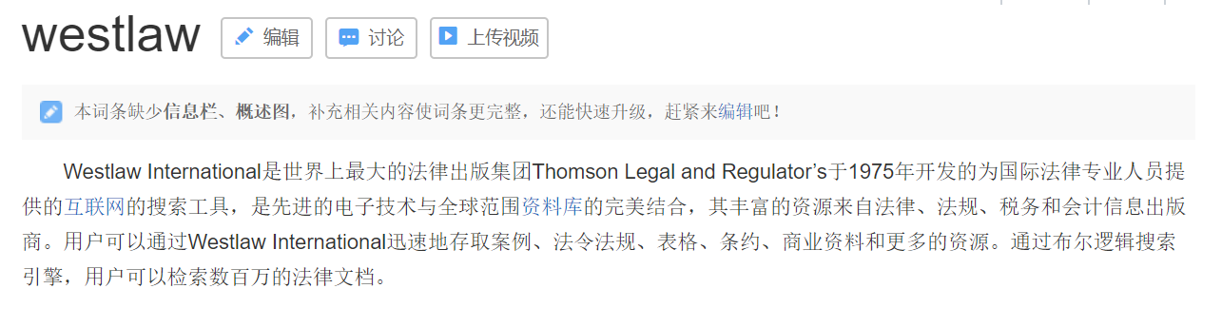
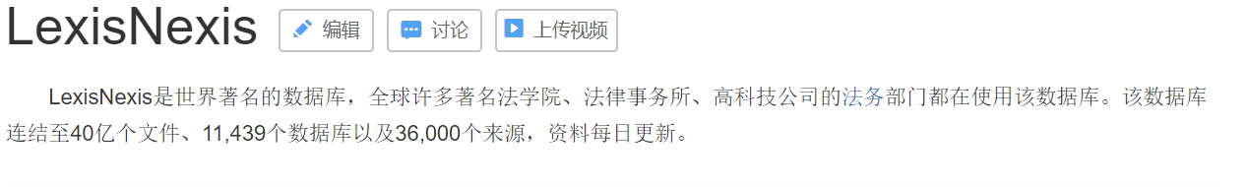

Tip

Slide 27
Introduction
Similarity measures between words, sentences, paragraphs, and documents are a prominent building block in majority of tasks in the field of Natural Language Processing
due to the syntactical complexities in the textual documents and the semantic structure of the text.
as the courts are binding upon precedent to know the law and knowing under which case that the laws were established and enforced is of utmost importance
the meaning of the words and context differs by the legal officers’ interpretations.

Slide 28
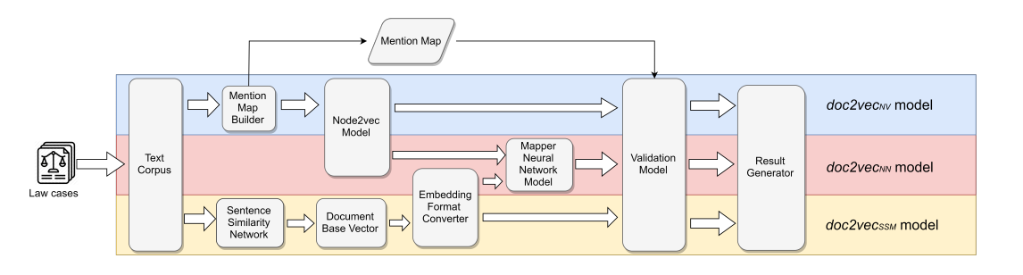
Method

Slide 29
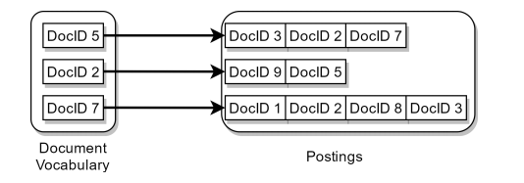
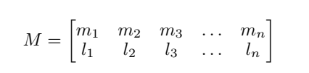
Mention Map
Mention
Rererence

Slide 30
Method

Slide 31
Sentence Similarity Graph Network
Base: This is mainly due to the fact that the semantic information contained in the words in sentences are an accurate representation of the overall semantics of the document.
we created a sentence similarity graph network using the semantic similarity measures between sentences by the TextRank algorithm .
Document corpus
we picked the most important sentences in each of the documents, from the sentence similarity graph network.

Slide 32
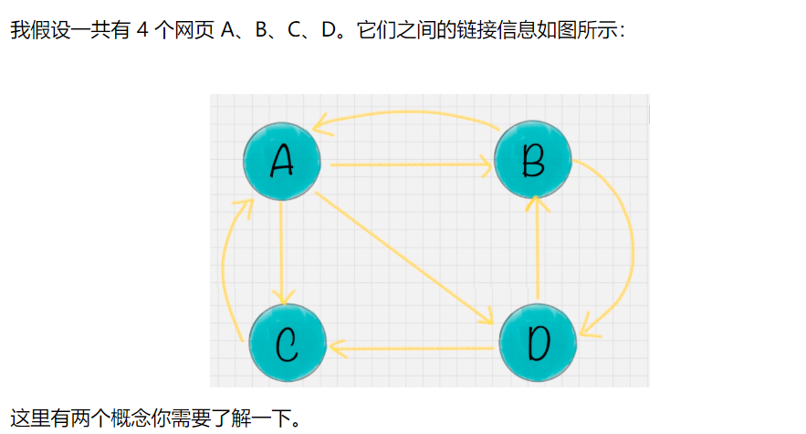
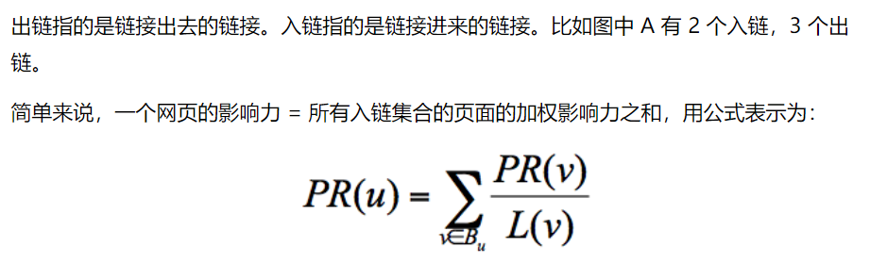
PageRank
https://www.cnblogs.com/jpcflyer/p/11180263.html

Slide 33
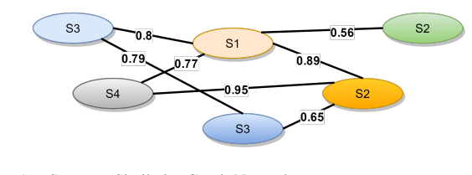
TextRank
Separate the document into sentences
Create a bag of words
create a similarity matrix A (by TF-IDF)
create a graph
Document corpus
we picked the most important sentences in each of the documents, from the sentence similarity graph network.

Slide 34
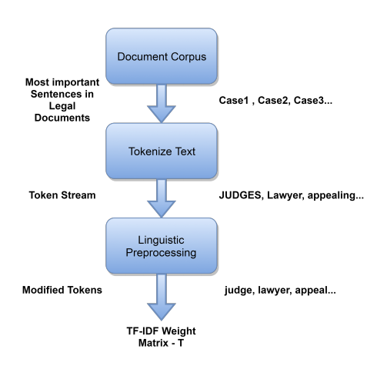
Text Preprocessing

Slide 35
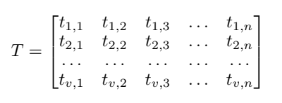
Document Base Vector Creation
T is a v × n matrix,
v is the size of vocabulary vector V
ti,j is the TF–IDF value of term i in document j of corpus D

Slide 36
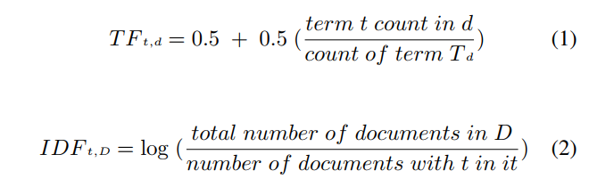
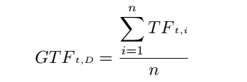







Document Base Vector Creation

Slide 37
Method

Slide 38
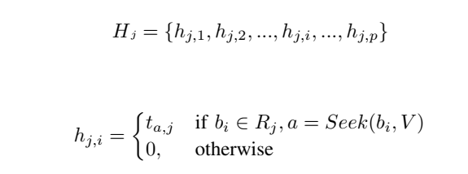
Sentence Similarity Based Document Vector Representation(B → H)
文档向量

Slide 39
Method

Slide 40
Scalable Feature Learning Node2vec Model
Model --> doc2vec_{NV} (by Node2vec)
input
(DocID 2, DocID 9 )
(DocID 2, DocID 5)
output
vector space that contains a set of feature vectors for the list of documents

Slide 41

Mapper Neural Network Model
build a model that could incorporate the different features in both of these vector spaces

Slide 42

Experiments
p = 250, 500,750,1000,2000
Evaluate: Recall

Slide 43
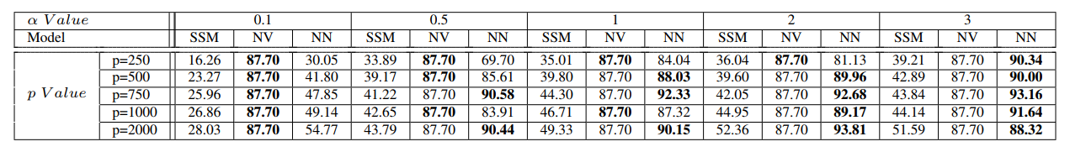
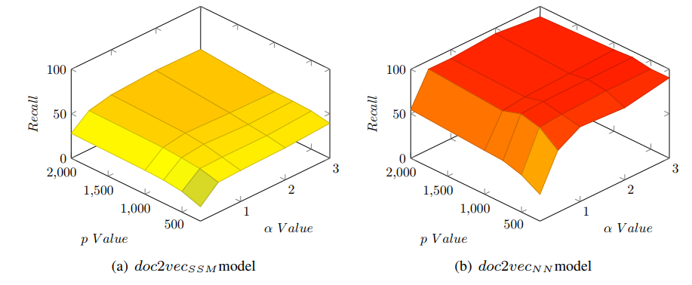
Results

Slide 44
Conclusion/Future Work
the doc2vec_{NN} model gives a significantly higher accuracy level
The trained model built using our neural network, can be extended towards other domains
The number of times a particular legal case is mentioned in a case was not taken into the account in this experiment.

Slide 45
Thank you

